Slide 1
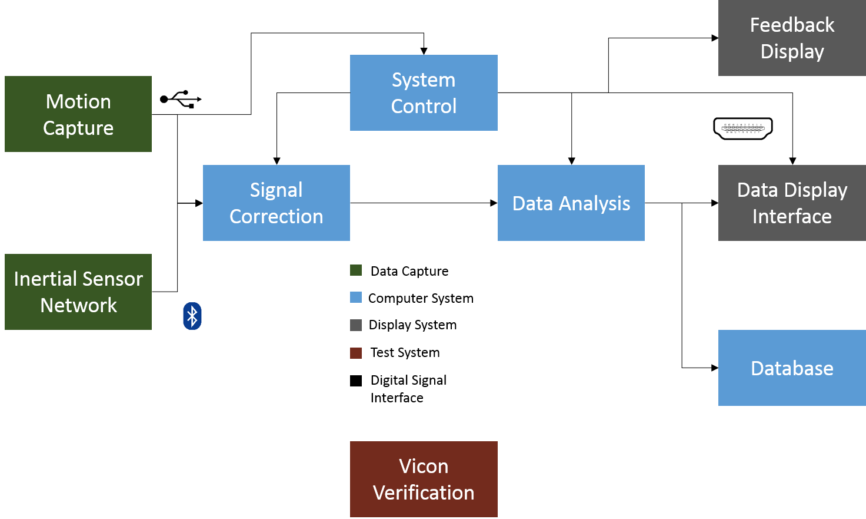

Slide 2
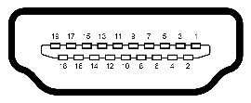


Feedback Display
System Control
Motion Capture
Signal Correction
Data Analysis
Data Display Interface
Inertial Sensor Network
Database
Data Capture
Test System
Vicon Verification
Computer System
Digital Signal Interface
Display System

Slide 3


